Slide 1
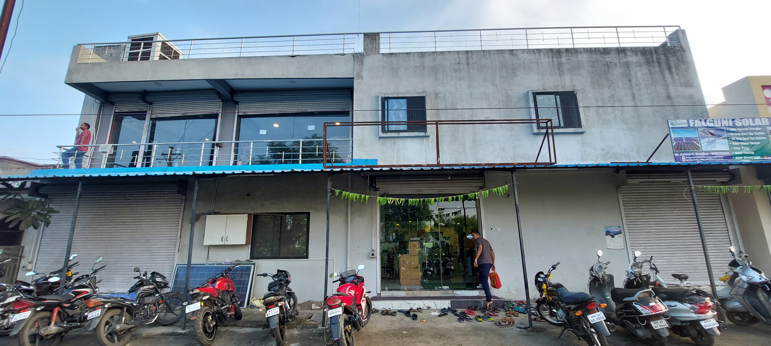
THE TRACK FITNESS CLUB
-By Arnav Kumar (21f2000426)

Slide 2
Contents
Executive Summary
Analysing the current situation
Analysis Method
Result and Findings
Recommendations
Month to Month revenue
Current Trends and Pattern
Overcrowding at peak hours
Retention Analysis
Overcrowding Analysis

Slide 3
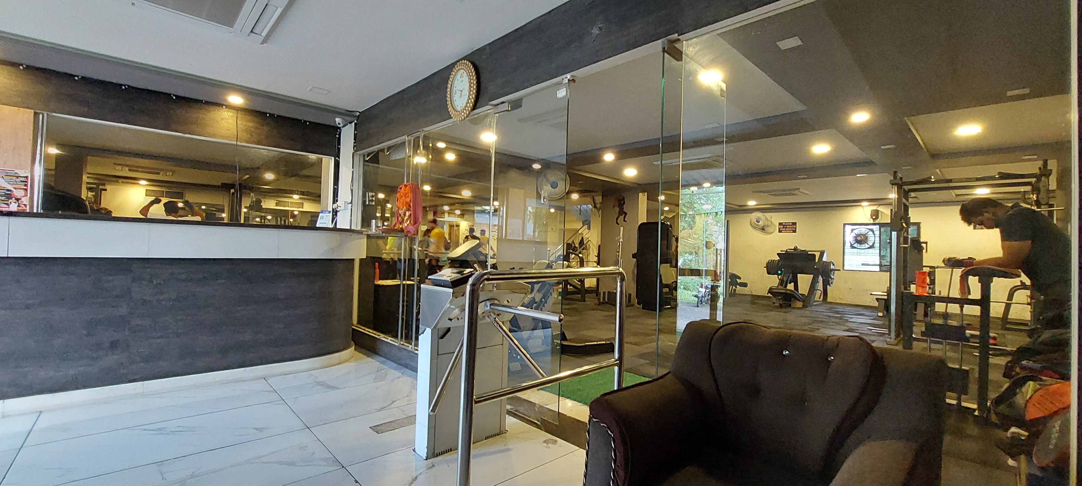
EXECUTIVE SUMMARY
The Track Fitness Club aims to provide affordable fitness to the city and is experiencing overcrowding and a low retention rate.
Cleaned invoice data and PII (personally identifiable information were used to improve retention rate through data analysis and insights
Data from January 2022 to August 2022 was analyzed and visualized using Microsoft Excel and Python to extract useful information

Slide 4
1. Month to Month Revenue
ANALYSING THE CURRENT SITUATION
The figure in the Right depicts the month wise revenue break of the fitness business
Monsoon Offer
The highest revenue of 275800 ₹ was obtained in the month of January which is approximately 18% of the total Revenue
March was the worst performing month, generating only 9% of revenue for the 8 month period."
As of august 2022 the business is sitting at an average revenue of 190530 ₹
Fig : 1

Slide 5
2. Current Trends and Patterns
Figure : 2
Figure : 3
The largest drop in registration of new clients was observed in the month of February. The drop was observed to be 50% as compared to the registrations in January.
The largest drop in generated invoice was among the month of June joiners where 51% of the June joiners didn’t made a consecutive recharge in the month of July.

Slide 6
3. Overcrowding at peak hours
"Reducing overcrowding will help clients access equipment more easily and improve retention rates, leading to long-term benefits for the business."
The gym was the most crowded during 7AM and 6PM with 4381 and 2955 total individual workouts respectively, taking place in the span on 8 month of data collection
Figure : 4

Slide 7
ANALYSIS METHOD
1. What are the factors which makes a client stay for as much as long as possible?
2. Might there be a few clients who are flexible with their workout schedule?
3. What is Adherence Rate?
Clean Data
Address the issue of low client retention
Identification of dedicated clients
Find traits associated with committed gym clients
Make use of the extracted information
Identify those flexible clients who prefers evening and noon slots
Make use of this extracted information
find solutions to alleviate overcrowding
Identification of flexible clients
A subset of active flexible clients who prefers afternoon or evening slot
A Set of all the unique clients associated with the track fitness club over a span of 8 months
A subset of clients who are flexible with their schedule ( flexible clients)
A subset of clients who are dedicated to the gym. The clients with high Adherence Rate
Figure : 5
Figure : 6

Slide 8
RESULTS AND FINDINGS
1. Retention Analysis
Fig A’s and Fig B’s represent the charts corresponding overall clients and high AR clients respectively
69% of the High AR clients are associated with personal trainers whereas the client-trainer association is a mere 19% when observed overall
There is a 8% drop in the number of females in the high AR client list compared to the overall statistics of 22%
Figure : 7A
Figure : 8A
Figure : 7B
Figure : 8B

Slide 9


2. Overcrowding Analysis
Figure : 9A
Figure : 9B
Figure 9A represents the current state of the gym. It can be seen that most workouts are taking place on 7AM and 6PM which is shown by a sharp peak in the chart which resembles overcrowding
Figure 9B represents the state of the fitness studio where every flexible client has worked out in either the noon or evening slot,. It can be observed that the peaks which were the direct consequence of overcrowding are flatten out
Should I go to the gym today? There is a lot of rush at this hour, maybe I will join another gym…
I feel more comfortable in the gym now, maybe because the rush at the peak hours is decreased somehow!! Anyway lets go workout!!

Slide 10

RECOMMEDATIONS FOR THE BUSINESS
What to do ?
What not to do ?
1. To retain a client as much as possible it is imperative to promote discounts which offers a taste of personal training to the client for example : a new year offer can be given out which offers personal training for a discounted price for a given duration
1. Plain discounts on subscription packages were unable to satisfactorily retain any clients in the past, hence such plain offers should be avoided. according to the data Such offers made the overcrowding worse and didn’t increased any revenue let alone any profits
2. Devise special offers exclusively for Flexible clients who prefer noon-evening slot, offering such clients a special discount if they choose to workout between 11am to 4pm
2. Using a price cut promotions every time lowers the perceived value of what the business offers hence such offers if at all necessary must be exercised with extreme caution or in the contrary should not be used at all
3. Hire a Female personal trainer

Slide 11
THANKYOU!

